Slide 1
机器人与人工智能实验室 Robotics and Artificial Intelligence Laboratory
WELCOME TO

Slide 2
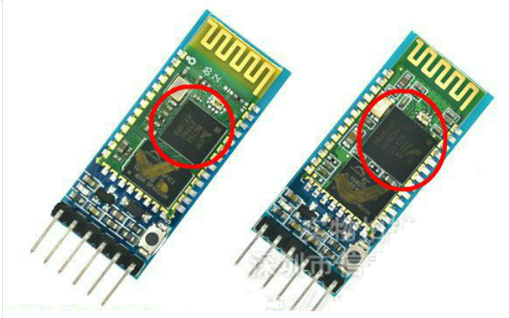
Control via Bluetooth
1. Preparation
The Bluetooth module HC-05.
The LED indicates the Bluetooth connection status:
A fast flash----------No Bluetooth connection
A slow flash---------The AT mode
A double flash------Bluetooth connected and port opened

Slide 3
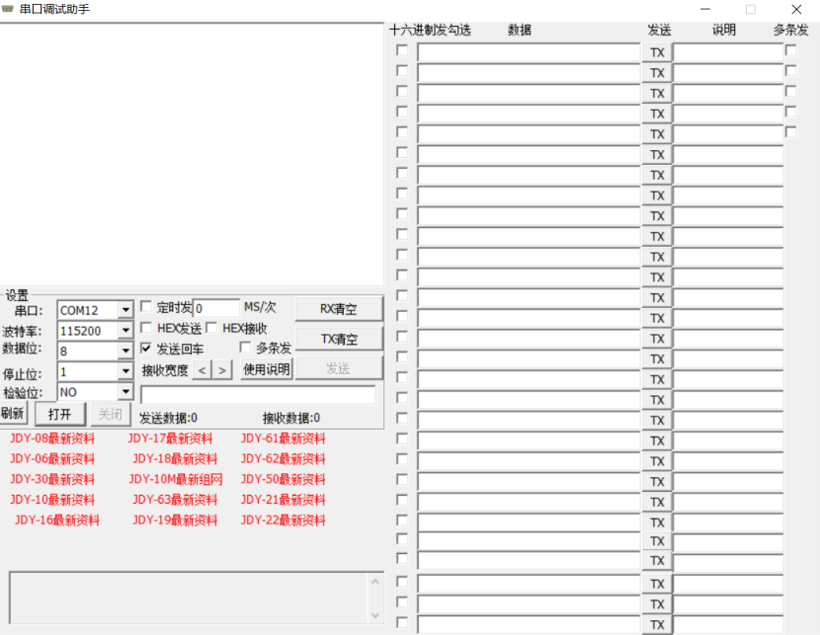
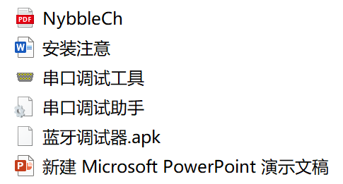
Control via Bluetooth
2. Debugging
AT mode (Next Slide)
Serial port tool

Slide 4
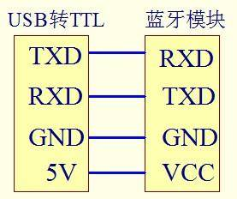
Control via Bluetooth
3. Setting for AT Mode
1. Connect the FTDI downloader to the HC-05 module with a DuPont cable with bus-connectors on both sides.

Slide 5
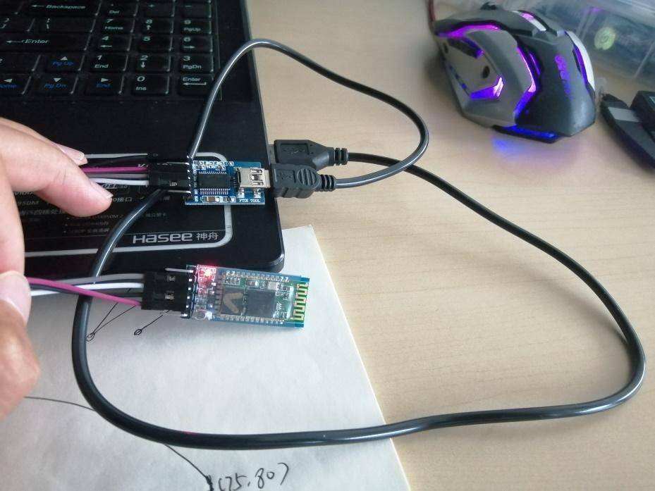
Control via Bluetooth
2. Press and hold the black button on the module, and then power on, you can enter the AT mode.

Slide 6
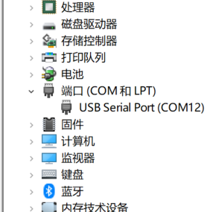
Control via Bluetooth
3. Find the device manager to see which port Bluetooth is currently on.

Slide 7
Control via Bluetooth
4. Open the software and set as follows:
(a) The baud rate (Customizable): 38400
(b) Serial port: COM12
(c) Check "Send Enter"
Then click the "Open" button.
Type in "AT" and the window returns OK. This shows that we have successfully entered the AT mode.

Slide 8
Control via Bluetooth
5. Enter the following commands successively. For each line of instructions, click Send.
(a) AT+NAME=Opencat9
(b) AT+UART=57600,0,0
(c) AT+ROLE=0
Every time a command is sent, it will return OK if setting successfully. We can see that a total of three OK are returned, indicating that all settings are valid.

Slide 9
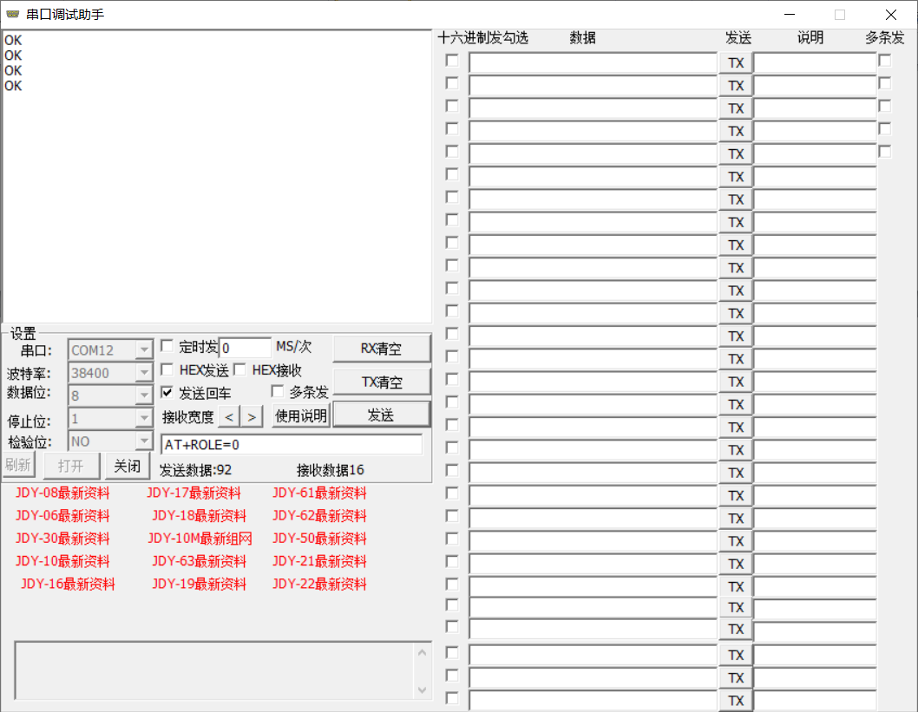
Control via Bluetooth

Slide 10

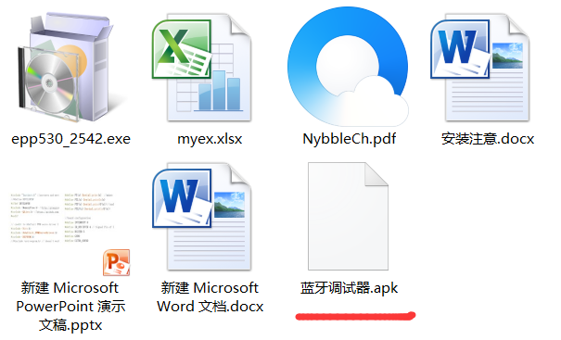
Control via Bluetooth
4. Bluetooth Connecting
1. Installing Bluetooth Debugger
P.S. APK provided:

Slide 11
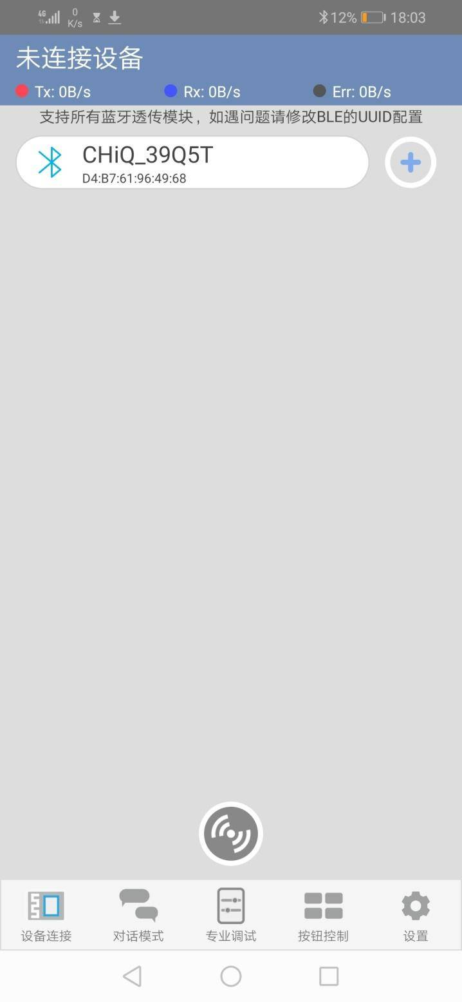
Control via Bluetooth
2. Connecting with the APP
Connect targets
Scan available devices

Slide 12
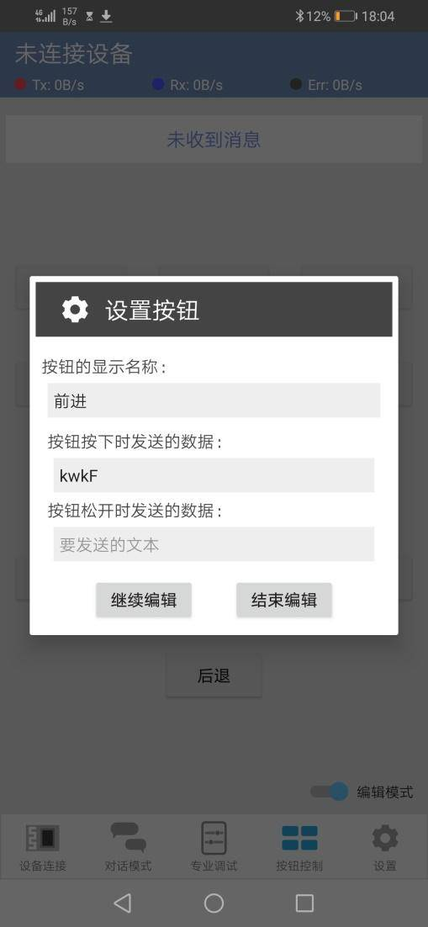
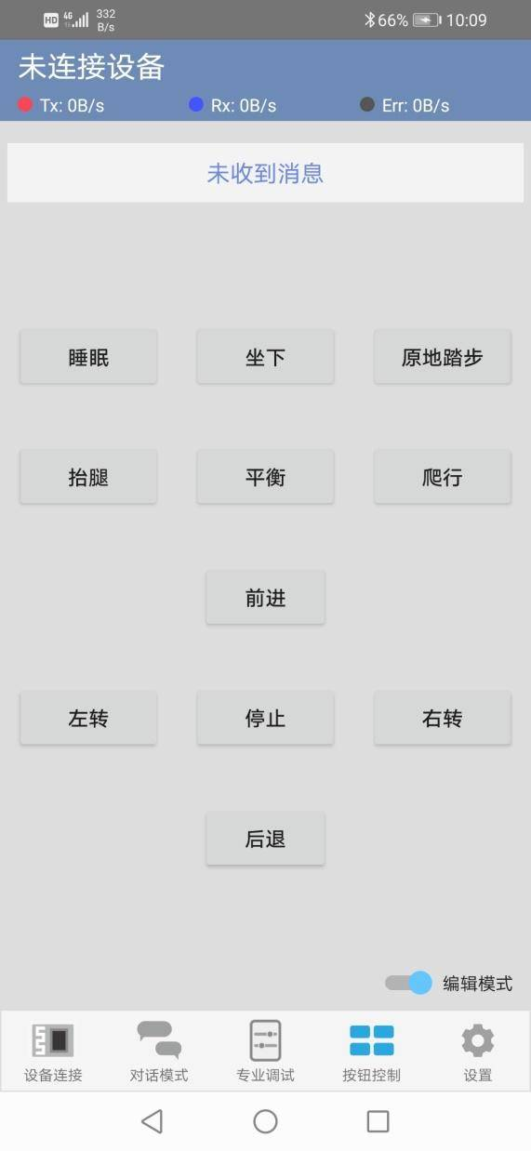
Control via Bluetooth
3. Edit commands
Detail:
krest or d - Stopping steering engine
kbalance - Standing still
kwk - Walking forward
kwkL - Turning left
kwkR - Turning right
kbk - Retreating
ksleep - Sleeping
ksit - Sitting down
kvt - Stepping on the same spot
kpee - Peeing
Kcr - Crawling

Slide 13
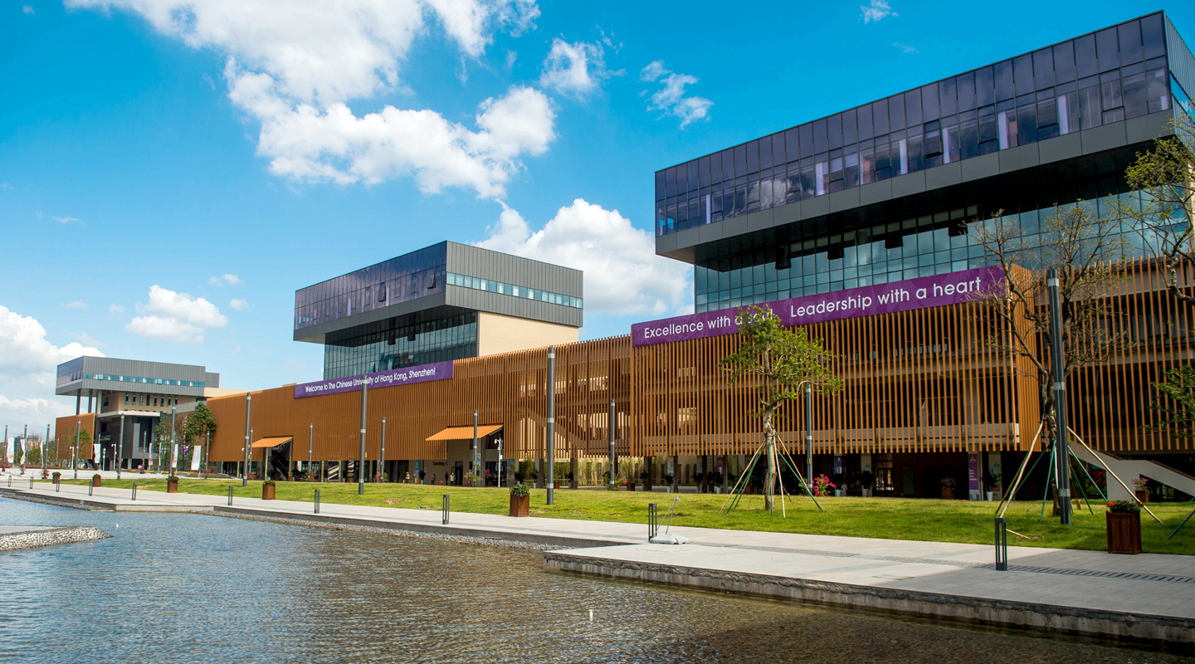
THANK YOU
林天麟 教授
香港中文大学（深圳）
机器人与人工智能实验室
WeChat: tinlunlam

